Slide 1

Backplane Bus Standards (Part 1)
VME Bus
  Introduction and Overview
  Mechanical Design and Signalling
  Basic Data Transfer Protocol
  Sub Modules
©Paul Davies. Not to be copied, used, or revised without explicit written permission from the copyright owner.
This lecture may contain animations and is best viewed as a slide show

Slide 2

VME Bus: History, Overview and Mechanical Design
VME bus can trace it’s origins as far back as the early 80’s with the introduction by Motorola of a new proprietary bus standard to support its UNIX based, EXORmacs 68000 based development system. In those days the bus was known simply as Versa bus.
Ratified in 1983 by IEEE and IEC as IEEE 1014 and IEC 821 and being given the name ‘Versa Module Europe bus’, or VMEbus.
VME bus was one of the first buses to use the highly reliable industry standard DIN-41612 two part connector in place of the old gold plated “finger” connector used in early bus designs. This reliability gave it an edge in industrial environments and lead to its wide spread adoption in that field.

Slide 3
VME Bus: History, Overview and Mechanical Design
During its life, VME bus has undergone several published revisions to the original standard in an attempt to extend the life of the bus and improve its performance in the face of competition from other competing bus standards. Examples include
  VME64 and VME64x enhancements for 64 bit data and faster clock speeds.
  VME320 and VXi offering high bandwidth in excess of 320MBytes/sec.
Today the number of manufacturers supplying VME bus products exceeds 300 worldwide, so it is still an influential bus. Today virtually all high performance processors are available as a plug in processor module, even though the original backplane signalling and protocol is closely related to Motorola’s 68000.
Bridge chips ensure any specific CPU signalling and protocol is compatible with VME bus standard. Bridge chips are available for VME/PCi conversion for example.

Slide 4
VME Bus Software Base
VME bus has possibly the largest installed software base of any industrial computer architecture.
There are at least 103 commercial operating systems known to be running on VME based processor boards including the popular offerings such as
  Unix,
  Linux,
  Windows,
  Solaris
  and real-time operating systems such as
  VxWorks,
  pSos,
  OS9/68k
  QNX Neutrino, LynxOS
  As well as a range of other proprietary "in-house" operating systems.

Slide 5
Applications of VME Bus
Industrial controls:
  Factory automation,
  Robotic control,
  Automotive assembly and painting,
  Steel production.
Military:
  Battlefield command & control systems,
  Ground and flight radar control systems
  Lockheed Martin Joint Strike Fighter F35 Program,
  Tank and gun controls - US Army Abrams M1 main Battle Tank,
  Field based Communications.
Aerospace:
  Avionics, fly-by-wire control systems,
  Spacecraft experiment control: In 1998 the Mars Pathfinder used a VME bus computer to control spacecraft operation on the planet Mars.
Transportation:
  Railway Signaling,
  Smart highway systems,
  Light-rail transit systems.

Slide 6
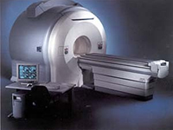
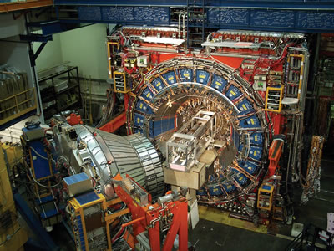
Current Applications VME Bus
Telecoms:
  Cellular phone “base stations”,
  Satellite up and down links
  Telephone switches - VME bus's live insertion capabilities make it attractive for telecoms applications although this area is becoming dominated by Compact PCi bus.
Simulation:
  Aircraft flight simulators used in training pilots,
  Earthquake & metal fatigue simulation – finite element analysis.
Medical:
  CATSCAN imaging,
  MRI imaging and various acoustical systems.
High Energy Physics:
  Particle accelerators/detectors.
  CERN in Geneva use VME bus products extensively to control their particle accelerator and simulators in their attempts to understand the makeup of the Atom
  The availability of DSP and Multiple Processor solutions make VME attractive as a high performance solution.

Slide 7
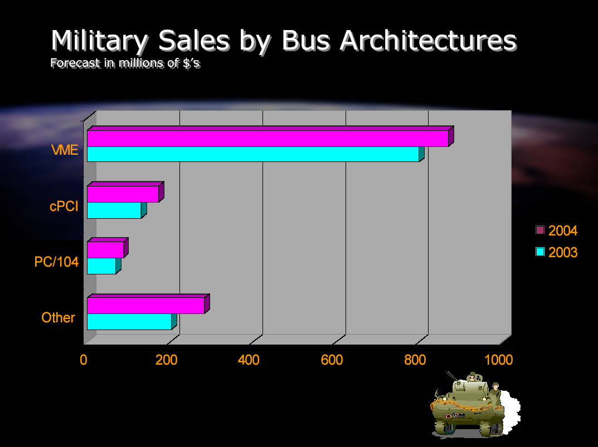
VME Bus: History, Overview and Mechanical Design

Slide 8
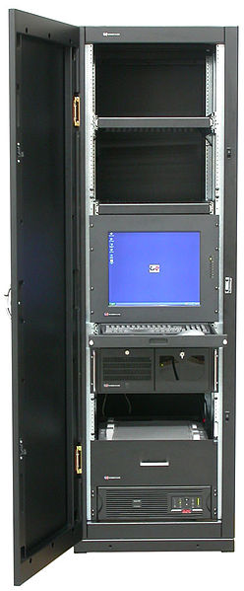
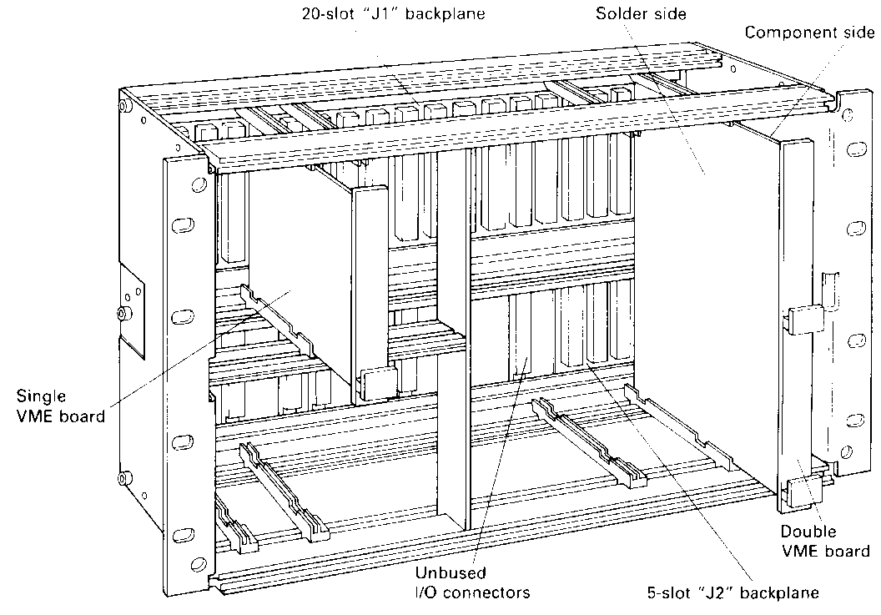
VME Bus: Mechanical Design
VME bus is a conventional plug-in ‘parallel backplane’ bus designed for rack mounting in an industry standard 19 inch wide cabinet.
Physically the cage and cards come in a variety of heights depending upon processing and performance requirements.
The cards themselves are based on a Eurocard format and dimensions are strangely expressed in multiples of ‘U’s.
The picture below illustrates a 6U double euro card height rack with both 3U (single height) and 6U (double height) cards.
The backplanes come in a variety of lengths ranging from 5 slots all the way up to the full compliment of 21 slots.

Slide 9
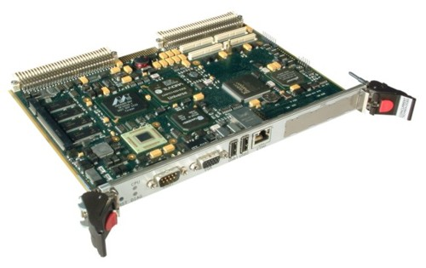
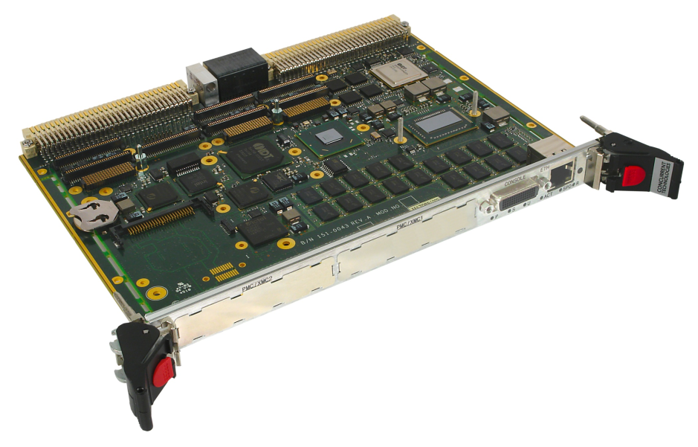
Some Sample VME Products
Concurrent Technologies 1.4GHz PowerPC
1.25 GByte DDR-SDRAM
64 MByte Flash
2Mbytes Battery Backed SRam
2 x 1Gbit Ethernet Channels
On board Graphics
4 x USB I, Serial Ports, Timers
VME to PCi expansion bus
Multiple Operating system support, Linux, VxWorks, Solaris etc.
Concurrent Technologies Quad Core I7
16Gb EEC DDR3 1333Mhz Dram
8Mbyte BIOS Eprom
VME to PCi expansion bus
On Board Graphics
Gigabit Ethernet
2 x SATA
Multiple Operating system support

Slide 10
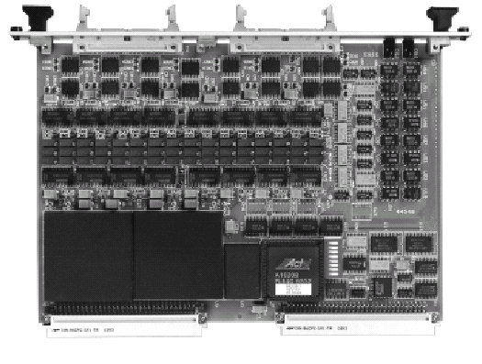
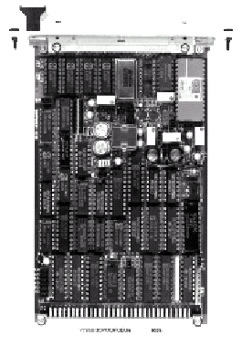
Some Sample VME Products
Xycom Automation (www.XycomVME.com)
XVME-531 16-Channel DAC Modules
6U form factor
12 bit resolution
16 independent Analog output channels
Voltage ranges of 0-10 V, ±5 V or ±10 V
XVME-500 ADC Module
3U form factor
16 Single Ended/8 Differential Input analog input channels (expandable to 32 SE/16 DI)
12-bit resolution.

Slide 11
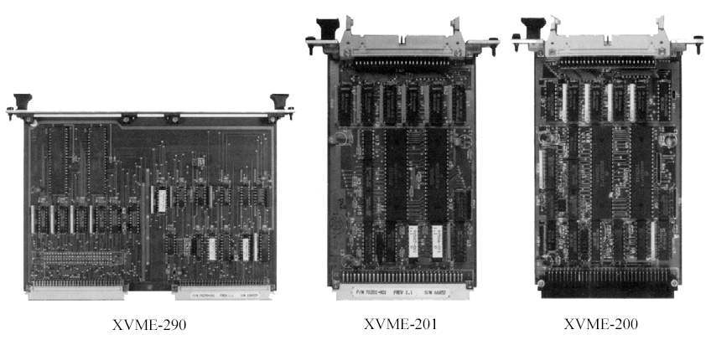
Some Sample VME Products
Xycom Automation Digital IO modules
32 x Digital IO channels
2 x 24 bit counter/timers

Slide 12
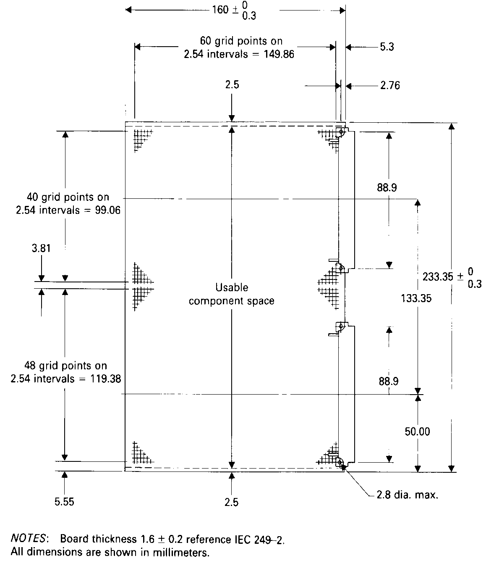
VME Bus: Mechanical Design
Eurocard Dimensions
A single ‘3U’ card measures 160 * 100 mm, and has a single 3 row, 96 pin, DIN41612 connector (P1) which carries the signals and functionality required to make a full 16 bit data/24 bit address system.
A double ‘6U’ card measures 160 *233.35 mm (i.e. more than twice the size of a 3U card) and has two connectors (P1 and P2).
P2 provides additional support for 32 bit address/data and caters for local (user defined) bus support, specific to that system.
Connectors J1/J2 refer to the female sockets fitted onto the backplane.
3U
P1
6U
P2

Slide 13
VME Bus: Pin-Outs
Signals closely mimic 68000 with scope for 32 bit expansion and Multiple CPU’s
P1/J1
16 bit data/24 bit address plus CLK, Interrupt and bus-arbitration signals on P1 connector
User-IO and support for 32bit data, 32 bit address on P2 connector
P2/J2
Pin # | Row A | Row B | Row C
1 2 3 4 5 6 7 8 9 10 11 12 13 14 15 16 17 18 19 20 21 22 23 24 25 26 27 28 29 30 31 32 | D0 D1 D2 D3 D4 D5 D6 D7 GND SYSCLK (16Mhz) GND DS1* DS0* WRITE* GND DTACK* GND AS* GND IACK* IACKIN* IACKOUT* AM4 A7 A6 A5 A4 A3 A2 A1 -12v +5v | BBSY* BCLR* ACFAIL* BG0IN* BG0OUT* BG1IN* BG1OUT* BG2IN* BG2OUT* BG3IN* BG3OUT* BR0* BR1* BR2* BR3* AM0 AM1 AM2 AM3 GND SERCLK SERDAT* GND IRQ7* IRQ6* IRQ5* IRQ4* IRQ3* IRQ2* IRQ1* +5v Standby +5v | D8 D9 D10 D11 D12 D13 D14 D15 GND SYSFAIL* BERR* SYSRESET* LWORD* AM5 A23 A22 A21 A20 A19 A18 A17 A16 A15 A14 A13 A12 A11 A10 A9 A8 +12v +5V
Pin # | Row A | Row B | Row C
1 2 3 4 5 6 7 8 9 10 11 12 13 14 15 16 17 18 19 20 21 22 23 24 25 26 27 28 29 30 31 32 | USER I/O USER I/O USER I/O USER I/O USER I/O USER I/O USER I/O USER I/O USER I/O USER I/O USER I/O USER I/O USER I/O USER I/O USER I/O USER I/O USER I/O USER I/O USER I/O USER I/O USER I/O USER I/O USER I/O USER I/O USER I/O USER I/O USER I/O USER I/O USER I/O USER I/O USER I/O USER I/O | +5V GND Reserved A24 A25 A26 A27 A28 A29 A30 A31 GND +5V D16 D17 D18 D19 D20 D21 D22 D23 GND D24 D25 D26 D27 D28 D29 D30 D31 GND +5V | USER I/O USER I/O USER I/O USER I/O USER I/O USER I/O USER I/O USER I/O USER I/O USER I/O USER I/O USER I/O USER I/O USER I/O USER I/O USER I/O USER I/O USER I/O USER I/O USER I/O USER I/O USER I/O USER I/O USER I/O USER I/O USER I/O USER I/O USER I/O USER I/O USER I/O USER I/O USER I/O

Slide 14
VME Bus: Sub-Buses
Although the VME bus itself is a single entity which cannot, physically be sub-divided, the functionality of VME bus can be partitioned into 4 distinct sub-buses on P1 connector.
Depending upon the type of card plugged into the backplane, it can tap into the signals of one or more of these sub-buses.
Typical arrangement of Modules
Typical arrangement of modules
Arbiter
CPU Card
CPU Card
DMA Capable
Peripheral
Dumb Peripheral
Memory
Module
User Interface
Reset
Power Monitor
Slot 1
Slot 2
Slot 3
Slot 4
Slot 5
Slot 6
Slot 7
Data Transfer Bus
Priority Interrupt
Arbitration
Utility

Slide 15
VME Bus: The Data Transfer Sub Bus
The Data Transfer Sub Bus
The data transfer sub bus represents that collection of signals involved in communicating data across the backplane from a data bus master to a data bus slave.
These signals are illustrated below with their equivalent 68000 signal. (Note that the use of 32 bit address and data requires the use of the P2 connector and a double (6U) euro card format).
From this it soon becomes apparent that the VME data transfer bus is little more than a simple extension of the basic 68000’s asynchronous bus. In fact, the timing and protocols associated with data transfer are intended to make interfacing to the 68000 as straight forward as possible.
The only features on the bus not directly present on the 68000 are DS0*, DS1* and LWord* (these signals are present on the 68020/30/40/60 used for transferring 32 bit data and variable/dynamic bus sizing) and the address modifier signals AM0-AM5.
The use of the signals AM0-AM5 is left up to the designer but could be used for a variety of purposes. More recently, as VME bus has evolved into VME64, VME64x (and VME320) AM0-AM5 have been used to indicate new protocols used to transfer data on a bus cycle by bus cycle basis, this allows newer boards to use newer protocols while older boards can continue to use the original ones thus ensuring backwards VME compatibility (40Mbytes/sec asynchronous transfers).
VME Bus Signal | 68000 Mnemonic | Name
A01-A31 D00-D31 AS* LWORD* DS0* DS1* WRITE* DTACK* BERR* AM0-AM5 | A01-A23 D00-D15 AS* NONE UDS* LDS* R/W* DTACK* BERR* NONE | Address Bus Data Bus Address Strobe Long Word (32 bit) Data Strobe 1 Data Strobe 0 Write Data Acknowledge Bus Error Address Modifiers

Slide 16
VME Bus: The Data Transfer Bus
Data Width:
VME bus (and VME64) supports a variety of data transfer widths using Dynamic bus sizing (using the signals DS0*, DS1* and LWORD*) with each address issued. Data transfer sizes can be 8-bit, 16-bit, 32-bit (and 64 bit with VME64)
Address Bus Width
The Address bus width used by the Master is determined by the setting of the Address Modifier codes[AM0-AM5]. The table below shows a range of codes used for each address bus width. The range includes the fact that different protocols for data transfer can be mixed with data width to create a range of different data transfers.
In addition it is common for these signals to also encode the 68000 Function Code Pins FC2-FC0 to indicate the type of access being performed, e.g. User/Supervisor, Data/Code, IACK.
Boards can either respond to these if they are able, or generate a BERR* if they
cannot deal with such a width/protocol.
Address Width | Address Modifiers AM0-AM5
64 Bit Address – [A63 – A01] 32 Bit Address – [A31 – A01] 24 Bit Address – [A23 – A01] 16 Bit Address – [A15 – A01] | 00-07 08-0F 38-37 29-2D

Slide 17
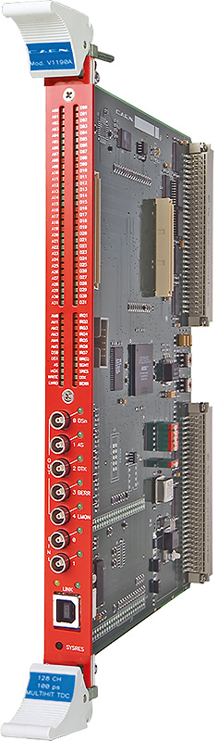
VME Bus: Sub-Modules
VME Bus Sub-Modules
VME Bus defines a number of Sub-modules and their functionality which may be present on certain boards.
These modules can be bought as chip-sets and provide all the timing and protocol required to interface to the Bus.
Centralised Data Bus Arbiter
This is a module that is able to receive all requests for use of the bus, prioritize them, and grant the bus to one bus master (e.g. a CPU or DMA capable Peripheral) at a time. That is, centralised arbitration in one place.
Also responsible for generating the 16MHz clock that runs along the backplane although this arbiter could be placed on a CPU board in a single CPU system.
The Data Bus Arbiter Module must be located in slot 1 for reasons that will become apparent later.
Arbiter
Slot 1
System
Clock
Driver
Data Bus
Arbiter
Data Transfer Bus
Priority Interrupt
Arbitration
Utility

Slide 18
VME Bus: Sub-Modules
Data Bus Master
A module capable of controlling data transfers across the bus. Typically in response to a CPU or DMA controller requesting transfer.
Data Bus Requester
A module capable of requesting control of the bus via the arbiter (see previous slide).
Interrupter Module
A module capable of generating an interrupt request onto the bus. Such modules exist for example on I/O cards or CPU cards with peripherals that can generate an interrupt.
Interrupt Handler Module
A module capable of detecting interrupt requests and initiating appropriate responses. Such modules probably exist on CPU cards and may have to take control of the bus in order to supply a vector number during an interrupt acknowledge so will work in conjunction with a Data bus master/Data bus requester module.
CPU Card
Peripheral
CPU or
DMA
Controller
Interrupter
Interrupter
IRQ
Vector #
DTB
Master
Bus Request/
Bus Grant
Interrupter
Bus Request, Bus Grant
Interrupter
Data Bus
Requester
Interrupt
Handler
Interrupter
Data Bus
Requester
Interrupter
IRQ Vector
Data Transfer Bus
Priority Interrupt
Arbitration
Utility

Slide 19
VME Bus: Sub-Modules
DTB Slave
A Data bus Slave simply monitors the Address and Data bus for Reads or Writes that are intended for it.
Once a correctly decoded address is received on the Data Transfer Bus, the Slave will transfers data between memory/IO on the board and the data transfer bus (issues Dtack* etc)
Memory or Peripheral
Module
Memory/
Peripheral
Memory/
Peripheral
Data
Bus
Slave
Data
Bus
Slave
Data Transfer Bus
Priority Interrupt
Arbitration
Utility

Slide 20
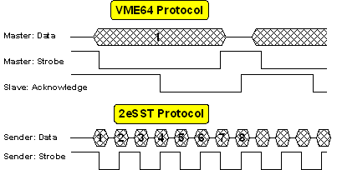
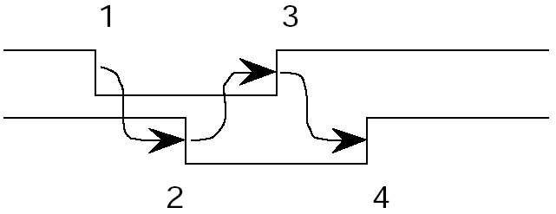
VME Bus: The Data Transfer Bus
Basic VME bus Data Transfer Protocol
  Simple Asynchronous Protocol requiring a handshake from Slave (as per 68000).
  Address and AM0-5 (Address modifier) bits are sent with each data transfer.
  Basic VME requires that signals traverse possibly the length of the backplane 4 times, (due to handshaking between processor module and slave module) making it slow by todays standards and limiting the original VME bus protocol to a bandwidth to just 40MBytes/sec.
VME Bus Protocol requiring handshake
Address and AM0-5 bits
1) CPU Data Strobe (DS0, DS1, LWord) travel up backplane to slave to indicate data is available
16/32 bit Data
3) CPU sees Slave acknowledge receipt of data and removes data, strobe and address
CPU Data Strobe: DS0-DS1-Lword*
Slave DTACK*
2) Slave asserts DTACK* onto backplane to indicate it has received/transmitted data, travels back down backplane to master
4) Slave removes acknowledge

Slide 21
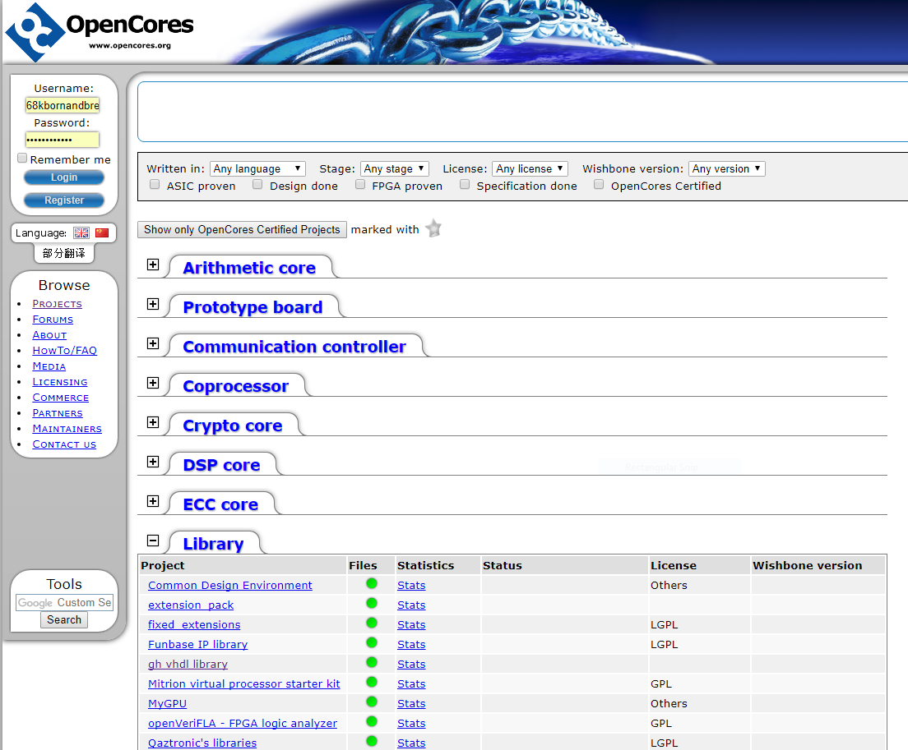
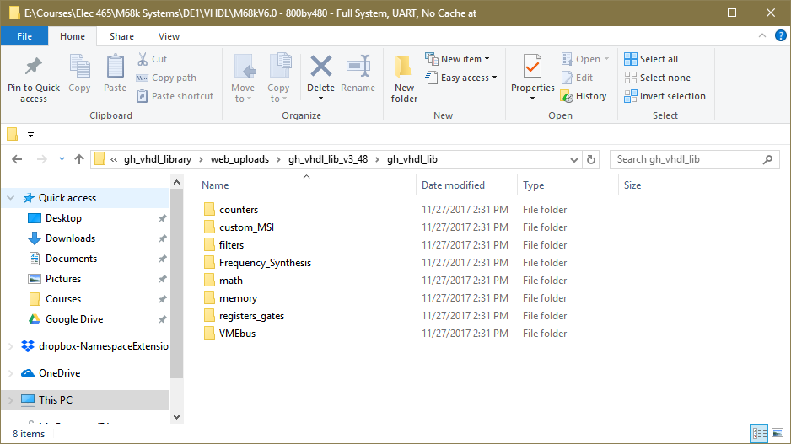
VME bus chipsets
For a number of years since it’s introduction, there have been companies that produced chip sets to handle the interface, protocol and timing associated with connecting a Master or Slave device to the VME backplane.
Due to increased use of FPGA technology on Microcomputer boards, demand for dedicated VME chip sets has diminished and has been replaced by VHDL or Verilog descriptions of them. https://www.xes-inc.com/embedded-technologies/fpga-vme-bridge/
OpenCores.org for instance has libraries of VME interface designs you can use for free.

